Slide 1


INTELLIGENT CONDITION BASED
MONITORING USING Acoustic Signals
for Air Compressors
Nishchal K. Verma, Senior Member, IEEE, Rahul Kumar Sevakula, Student Member, IEEE,
Sonal Dixit, Student Member, IEEE, and Al Salour
Presented by
Group 17
Ram Haneesh (230053)
Vooba Rajkumar (231173)
Guna Sekhar (230537)
Shreehari P (230985)

Slide 2
OBJECTIVE OF THE PAPER
To develop and validate a complete, intelligent fault diagnosis system for a reciprocating air compressor using a fault detection model.
PROBLEM
Unexpected machine breakdowns in industry lead to heavy financial losses and safety hazards.
Traditional maintenance (preventive, breakdown) is often inefficient or too late.
SOLUTION
Condition-Based Monitoring (CBM)
CBM is a strategy that monitors the actual condition of an asset to decide what maintenance needs to be done

Slide 3
OVERVIEW
A data driven approach for fault diagnosis using acoustic signal follows this systematic and modular pipeline:
Data Aquisition
Sensitive Position Analysis
Pre-processing
Classification
Feature Selection
Feature Extraction
The proposed fault diagnosis model was tested on an air compressor in a real world.
To evaluate its performance, the machine was operated under eight distinct conditions:
1 Healthy Condition and 7 Faulty Conditions (LIV, LOV, NRV, Piston Ring,
Flywheel, Rider Belt, and Bearing.)

Slide 4
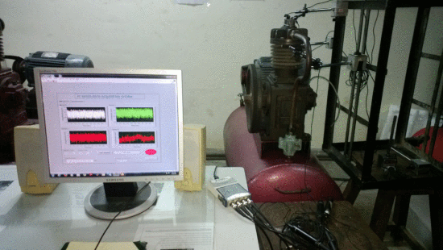
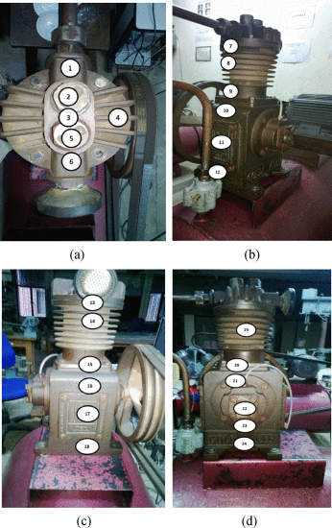
DATA ACQUISTION
Setup Overview:
Unidirectional microphones used to reduce background noise.
Microphones placed approximately 1.5cm from compressor.
Data captured using NI 9234 (4-channel DAQ module).
NI 9172 USB interface and LabVIEW for acquisition.
Recording Configuration:
• 5-second recordings per condition, Sampled at 50 kHz.
• Stored in 24-bit PCM format (.dat files).
• Each recording contains 250,000 samples.
Sensor Placement Strategy:
• Initial recordings taken from 24 different positions.
• Positions selected based on experience and intuition.
• Sensitive Position Analysis (SPA) is used to select the best
microphone locations.

Slide 5
PROPOSED APPROACH FOR PLACING THE SENSOR
Sensitive Position Analysis (SPA):
It identifies locations most responsive to faults.
At each position, four statistical features were calculated:
1. Absolute Peak Value
2. Standard Deviation
3. Variance
4. Root Mean Square (RMS)
Computed 4 statistics (peak, mean, SD, RMS), summed their ranks and ranked all positions.
Used cross-correlation to avoid redundancy.
Drawback: This method performs poorly when noise is high, especially white noise.
So, we use EMD:
EMD decomposes a signal into Intrinsic Mode Functions (IMFs) based on local extrema.
In SPA, EMD is used to isolate meaningful signal components from noisy data.
Relevant IMFs are retained to enhance sensor position selection accuracy.

Slide 6




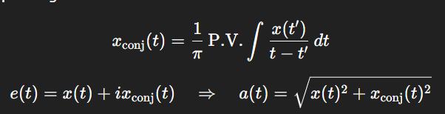
Decomposes signal x(t) into IMFs + residue:
Helps isolate noise by retaining only relevant IMFs based on:
repeat until,
&
Select relevant IMFs based on correlation with original signal.
Reconstruct signal using selected IMFs:
Find signal envelope using Hilbert Transform:
Calculate RMS and Absolute Mean of the envelope.
Average across N recordings for each position.
Rank positions:
Descending order for each feature.
Final rank = sum of individual ranks → Lowest sum = Best position.

Slide 7
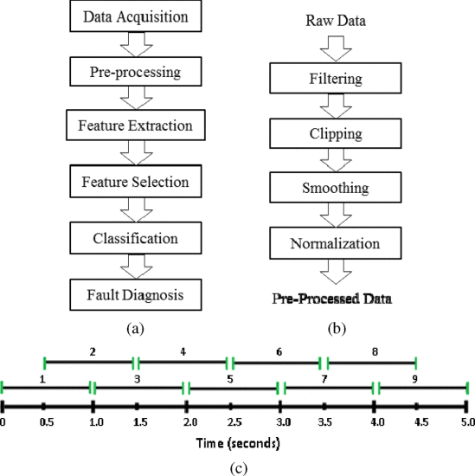
PROPOSED PRE-PROCESSING STRATEGY
Why Pre-Processing?
Raw signals may contain noise, outliers, inconsistencies.
Improves signal quality for feature extraction.
Filtering:
Removes unwanted frequency components.
Two-stage filtering:
1. High-pass filter at 400 Hz 2. Low-pass filter at 12 kHz.
Clipping:
Split 5-sec signal into 9 overlapping 1-sec segments.
Select a segment with a minimum standard deviation.
Avoids spikes & transients.
PRE-PROCESSED DATA
Smoothing:
Reduces effect of outliers.
Filters tested: Moving Average, Median, Savitzky-Golay, Geometric Mean.
Moving Average is used for smoothing.

Slide 8
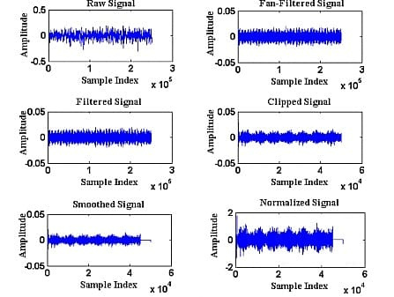
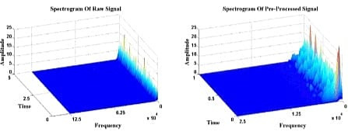
Normalization:
Standard max-min normalization is sensitive to outliers.
This removes the top and bottom 0.025% of signal values (based on Gaussian distribution intuition) before scaling the data from -1 to 1. This makes the process more robust.
Spectrogram plots of signal before and after
pre-processing
Plots of signal at every step of
pre-processing

Slide 9
FEATURE SELECTION
Why Feature Extraction?
Overall system performance depends on quality of extracted features.
Features are extracted from three primary domains:
Time Domain (TD):
In the time domain, features are derived directly from the original signal using statistical measures such as:
Mean, Maximum Peak, RMS, Variance, Kurtosis, Skewness, Crest Factor, and Shape Factor
Number of Time Domain Features: 8
Frequency Domain (FD):
The frequency domain provides insight into the signal’s energy distribution using the Fast Fourier Transform (FFT).
The ratio of energy in each bin to the total energy gives 8 features.

Slide 10
Time-Frequency Domain (TFD):
Time-frequency methods are ideal for analyzing non-stationary signals. Three techniques are used:
1. Morlet Wavelet Transform (MWT): features extracted 7.
2. Discrete Wavelet Transform (DWT): features extracted 9.
3. Wavelet Packet Transform (WPT): features extracted 254.
Total Features from Core Methods: 286
Additional 343 features were later extracted using 10 more transforms like DCT, STFT, S-Transform, WVD, etc.
Grand Total of 629 Features were extracted.

Slide 11
FEATURE EXTRACTION
Why is Feature Selection Important?
When you have too many features, it becomes hard for the model to learn properly. This is known as the curse of dimensionality.
Feature selection helps reduce the number of features while keeping the most important information.
It improves classification accuracy and reduces model complexity.
Projection-Based Method:
Principal Component Analysis (PCA): Transforms correlated features into new uncorrelated axes (principal components) based on maximum variance.
2. Mutual Information-Based Methods:
Mutual Information Feature Selection (MIFS): Selects features with high relevance to the class and low redundancy with previously selected features.

Slide 12
Minimum Redundancy Maximum Relevance (mRMR): Enhances MIFS by using a fixed inverse of selected features as a redundancy penalty weight.
Normalized Mutual Information Feature Selection (NMIFS):Uses normalized mutual information to fairly compare features for selection
MIFS under Uniform Distribution (MIFS-U):Assumes uniform distribution of information across features for unbiased selection.
3. Distance-Based Method:
Bhattacharyya Distance (BD): Ranks features based on how well they separate class distributions using statistical distance.
NMIFS and mRMR feature selection techniques shows the best performance among all the methods
Ideal range for selecting the features is 25-50.

Slide 13

CLASSIFICATION FOR FAULT RECOGNITION
Goal:
To build a model that can predict the machine's state based on the selected features.
Algorithm Used:
Support Vector Machine (SVM) with a Radial Basis Function (RBF) kernel. SVM is known for its strong generalization ability.
In the linearly separable case, SVM finds the maximum-margin hyperplane between two classes:
Multiclass Strategy:
Three strategies were compared:
1. OAO (One-Against-One): Trains a classifier for every pair of classes.
Builds M(M−1)/2 binary SVM models for M classes.
Each model separates one class from another.
Classification is done by majority voting among models.

Slide 14
2. One Against All (OAA)
Builds M SVM models, each separating one class from all others.
More computationally expensive due to SVM's O(n^2)complexity.
3. Decision Directed Acyclic Graph (DDAG)
Uses same number of models as OAO (M(M−1)/2) during training.
During testing, only (M−1) models are used per sample.
A binary DAG is used where each internal node is an SVM model.
SETUP
A real-time fault diagnosis system was tested on a single-stage reciprocating air compressor.
The compressor specifications included:
Pressure range: 0–500 lb/in² (0–35 kg/cm²)
Motor: 5 HP, 415 V, 5 A, 50 Hz, 1440 rpm
Pressure switch: PR-15 (100–213 PSI)

Slide 15
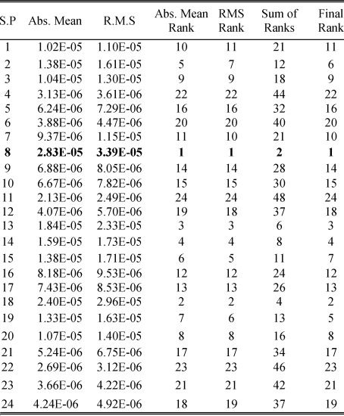
CASE STUDY
For each state, 15 recordings were captured, giving a total of 1800 acoustic recordings.
By SPA we found position 8 to be consistently the most sensitive for all 8 machine conditions.
From the data collected from position 8 is then subjected to data pre-processing
Two feature extraction experiments were performed:
Phase A: Extracted 286 features from time, frequency (FFT), and wavelet domains (MWT, DWT, WPT).
Phase B: Added 343 more features using transforms like DCT, STFT, WVD, CWD, etc., making a total of 629 features.
As there are 8 states for our input we are using mutli-class SVC.

Slide 16
OBSERVATIONS
C-SVM with RBF kernel was used due to its generalization strength.
Parameters C and γ for SVM were optimized across a range of exponential values.
Cross-validation was done using 2, 3, 4, 5, and 10 folds for robust accuracy assessment.
Even with just 2-fold cross-validation, very high accuracy (~94%) was achieved.
Best feature selection methods:
1. mRMR 2. NMIFS
OAO and DDAG classifiers gave excellent results while keeping computation efficient.
Phase A (286 features): Best accuracy 94.67%
Phase B (629 features): Accuracy improved to 96.61%
Performance saturated around:
1. 25–50 features in Phase A 2. 10–15 features in Phase B
Computation time details:
1. Extracting 286 features: ~0.9 seconds per recording
2. Extracting additional 343 features: ~206 seconds per recording

Slide 17
CONCLUSION
This system accurately identified faults using just a single microphone.
To balance performance and speed
Selecting features only from the most effective transforms
Using mRMR to select ~25 features
Classifying using OAO-SVM with RBF kernel
This strategy achieved over 99.5% accuracy with 9–10 seconds per recording in real-world testing.
mRMR emerged as the most reliable feature selection technique across all experiments.
Among the classifiers, OAO and DDAG offered the best trade-off between accuracy and speed.
Future Scope:
Develop methods to detect multiple faults simultaneously.
Implement adaptive learning to handle time-varying machine behavior.
Make the model suitable for real-time (online) fault diagnosis with minimal computation.

Slide 18
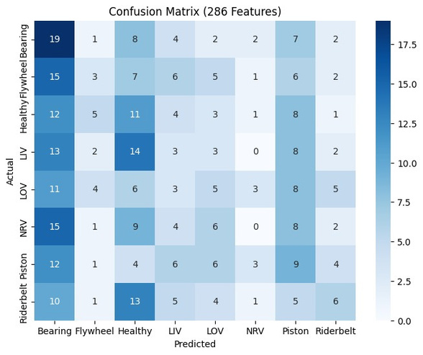
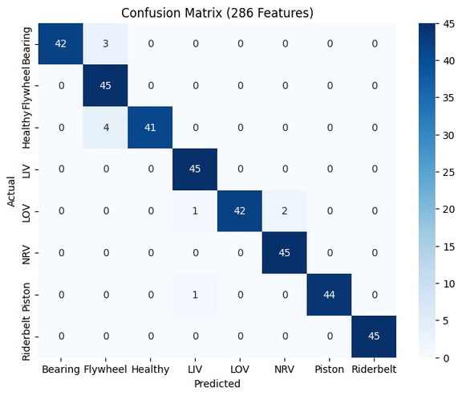
CONCLUSION
Results and Conclusion from our implemented code
What we observed:
In our 286-feature, OAO model, accuracy was low when using less than 30 features.
As we increased the number of features from 30 to 45, the accuracy improved noticeably.
In our 286-feature, OAO model, accuracy is around 15.55% for 25 selected features, and accuracy is improved to 96.94% when 30 features were selected.
Our results show a similar trend to the paper. As it is mentioned, best results were observed around 25 to 50 selected features.
We can see that accuracy improved when features increased from 25 to 30 from these confusion matrixes.
Confusion matrix for 25 feature selected
Confusion matrix for 30 feature selected

Slide 19
Thank You
For your attention

